Slide 1

Sprint 6 Presentation
Golf Player Time Management
Adam Horle, Alyssa Beeker, Bailey Carlin, Daniel Teel, Elijah Hunt

Slide 2
Admin App Finishing Touches
Loading bars and spinners
Gives users feedback and removes the question of “is it working?”
Performance improvements
Reworked some functions that significantly increased speed
Calculated wait times
Worked out from reading studies (there’s a surprising amount of them) that for every par stroke the average is 3.2 minutes of play
Line graph that shows this to the user with a table to show the number of current games per hole
Added in password reset functionality via email - forgot about this key feature but it was simple to add
Field that tells the user if the geofence is complete or not
Finished support page
Walkthroughs and developer contact email

Slide 3
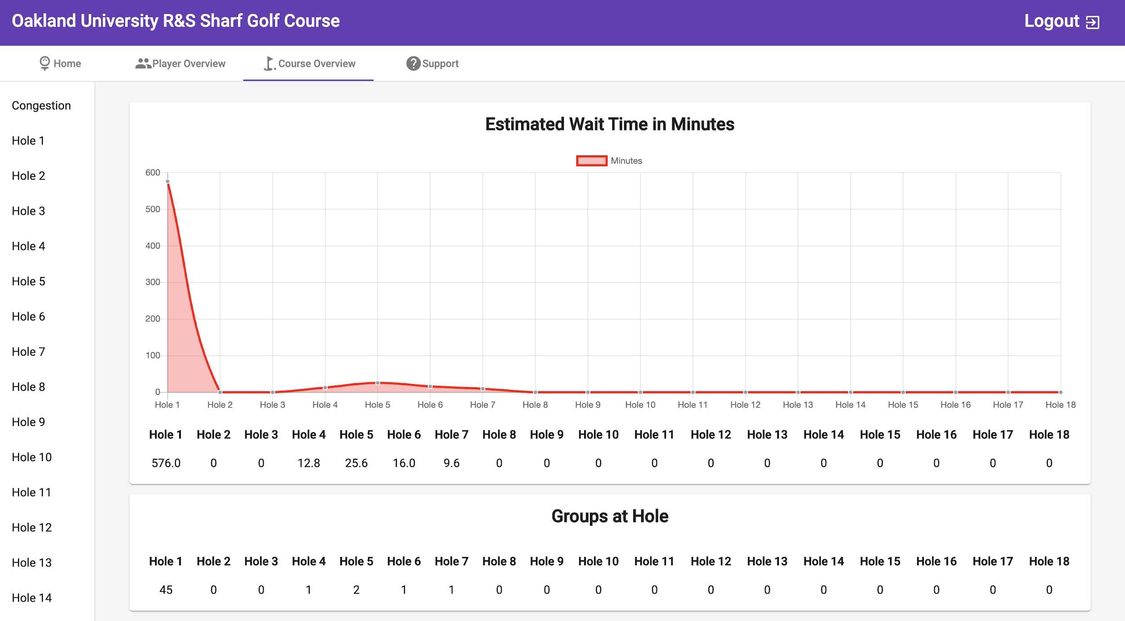

Slide 4
Mobile App
Players can now join games they have been added to
Players location is being displayed on the map.
Players can select a target on the map and it will display the distance and what type of club to use.
Players can view an overview of the current game.
Players can view next hole info. Includes number of games on the hole, number of players on the hole and wait time on the hole.
Players can request assistance from the admin.
A lot of front end work.

Slide 5
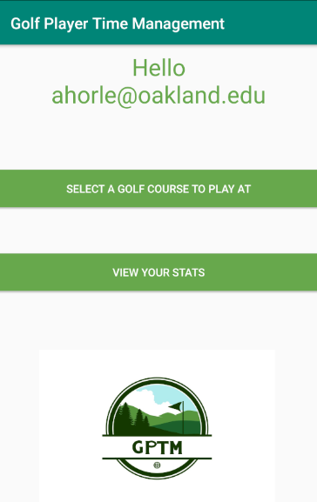
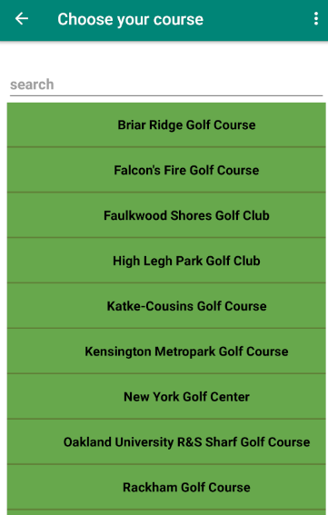
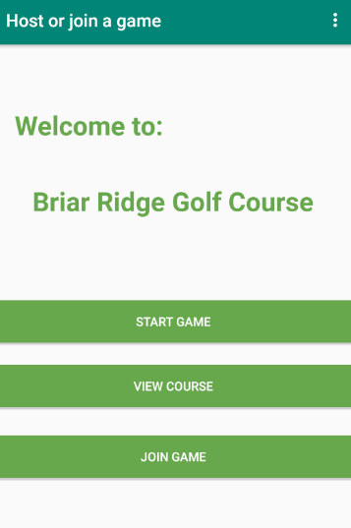
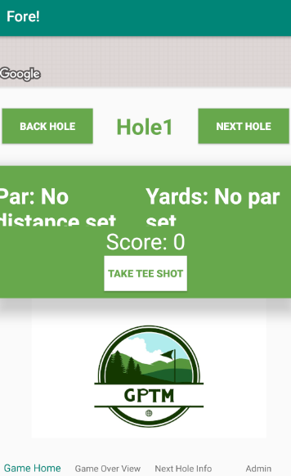
Revamped UI

Slide 6
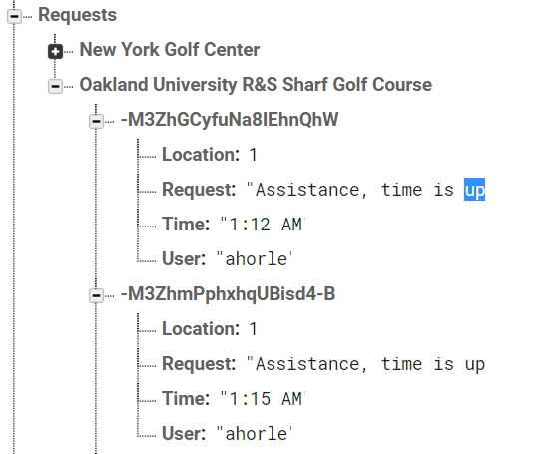
Revamped Timer
Timer now implemented into fragment controller activity to run in the background
Sends request to firebase as assistance when time is up

Slide 7

Selecting Targets and Getting Tips

Slide 8
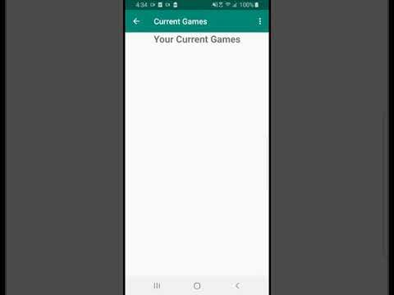
Joining Current Game and Game Activity UI

Slide 9

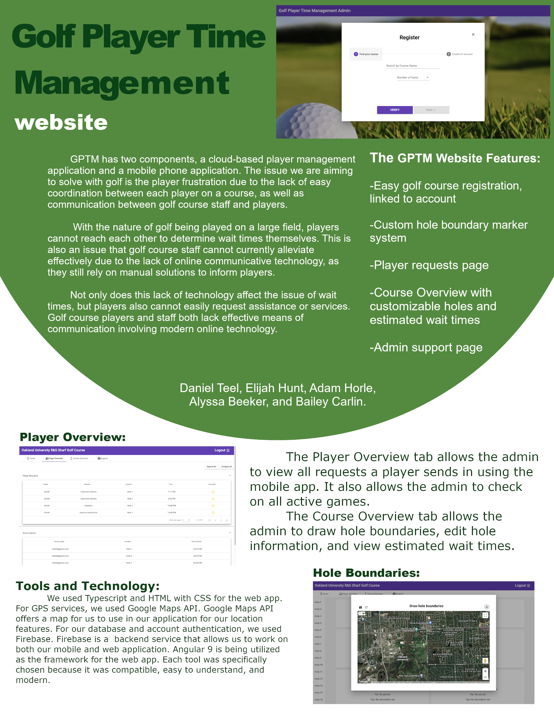
Posters
One for website and one for mobile

Slide 10

Challenges Encountered
Remote collaboration
CSS annoyances
Xml and fragment annoyances
Google Map API not working on emulator

Slide 11

Preparation for the Final
Finish up all documentation
Project poster
Squash any remaining bugs if they’re discovered
Fix up mobile apps remaining front end issues.
Prepare and rehearse final presentation

Slide 12
Demo Link
https://golf-player-time-management.firebaseapp.com

Slide 13
Questions

